Slide 1
Fundamental Concepts of Probability
Dr. Uzair Ahmad

Slide 2



Random Processes
In a random process we know what outcomes could happen, but we don't know which particular outcome will happen.

Slide 3

Probability
P(A) = Probability of Event A
There are several possible interpretations of
probability but they (almost) completely agree on the mathematical rules probability must follow: 0 ≤ P(A) ≤ 1
Frequentist’s (Traditional) Interpretation
The probability of an outcome is the
proportion of times the outcome would
occur if we observed the random
process an infinite number of times.
Bayesian Interpretation
A Bayesian interprets probability as a
subjective degree of belief.
Largely popularized by revolutionary
advance in computational technology and
methods during the last twenty years.
Notes:
Bayesian Interpretation: A subjective degree of belief. Two different people can have different viewpoints about probability of an Event. This interpretation allows prior information to be integrated in inferential framework.

Slide 4
law of large numbers
As more observations are collected, the proportion of occurrences with a particular outcome converges to the probability of that outcome.
http://en.wikipedia.org/wiki/File:Lawoflargenumbersanimation2.gif

Slide 5
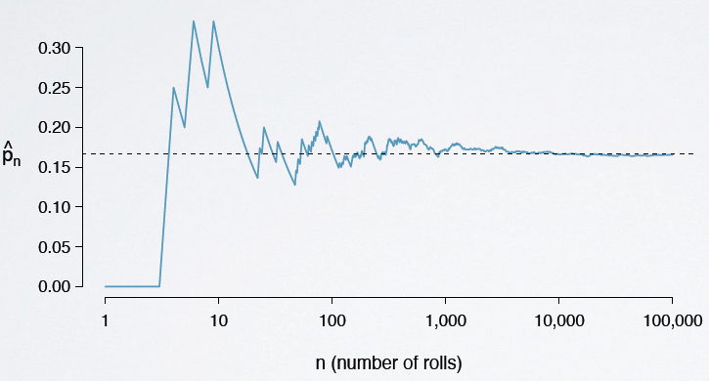
law of large numbers
As more observations are collected, the proportion of occurrences with a particular outcome converges to the probability of that outcome.

Slide 6
Which of the following events would you be most surprised by?
exactly 3 heads in 10 coin flips
exactly 3 heads in 100 coin flips
exactly 3 heads in 1000 coin flips

Slide 7

Say you toss a coin 10 times, and it lands on Heads each time. What do
you think the chance is that another head will come up on the next
toss? 0.5, less than 0.5, or more than 0.5?
H H H H H H H H H H ?
The probability is still
50%:
P(H on the 11th toss)
= P(H on the 10th toss)
= 0.50
Common misunderstanding of law
of large numbers:
gambler’s fallacy
Notes:
Coin is memory less.
Gambler’s Fallacy: Random processes are supposed to compensate for whatever happened in the past.

Slide 8
Types of Event
disjoint events
complementary events
Independent / dependent events

Slide 9
Disjoint vs. Non-Disjoint
Disjoint (Mutually Exclusive)
Events that cannot happen at the same time.
the outcome of a single coin toss cannot be a head and a tail.
a student can’t both fail and pass a class.
a single card drawn from a deck cannot be an ace and a queen.
Non-Disjoint
events that can happen at the same time.
A person can be a student and an employ in university at the same time.
A
B
A
B
P(A and B) = 0
P(A and B) > 0

Slide 10
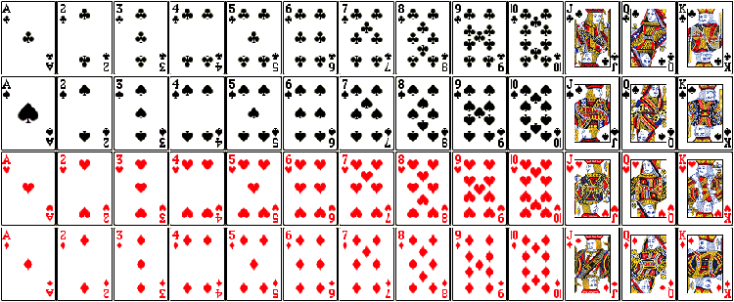
Probability of disjoint events
What is the probability of drawing a Jack or a Three card from a well shuffled full deck of cards?
For disjoint events A and B, P(A or B) = P(A) + P(B) ➔

Slide 11
Probability of non-disjoint events
What is the probability of drawing a Jack or a red card from a well shuffled full deck of cards?
For disjoint events A and B, P(A or B) = P(A) + P(B) –P(A&B)➔

Slide 12
General rule:
P(A or B) = P(A) + P(B) - P(A and B)
A
B
A&B
Note: When A and B are disjoint, P(A and B) = 0, so the formula simplifies to P(A or B) = P(A) + P(B).

Slide 13
What is the probability that a randomly sampled passenger will be stopped or he is a non-ME national ?
 |  | Immigration Clearance
 |  | Stopped | Cleared | Total
Nationality | ME | 21 | 13 | 34
 | Non ME | 10 | 24 | 34
 | Total | 31 | 27 | 68
(AB)
(B)
(A)

Slide 14
Sample Space
A collection of all possible outcomes of a trial.
Flip two coins 100 times.
What is the sample space for the results of the experiment.
S = {HH, HT, TH, TT}

Slide 15
Probability Distributions
List of all possible outcomes in the sample space,
and the probabilities with which they occur
One Coin Toss | Head | Tail
Probability | 0.5 | 0.5
One Coin Toss | Head, Head | Head, Tail | Tail, Head | Tail, Tail
Probability | 0.25 | 0.25 | 0.25 | 0.25
rules
1. the events listed must be disjoint
2. each probability must be between 0 and 1
3. the probabilities must total 1

Slide 16
Complementary Events
Two mutually exclusive events whose probabilities add up to 1.
One Coin Toss | Head | Tail
Probability | 0.5 | 0.5
complementary
One Coin Toss | Head, Head | Head, Tail | Tail, Head | Tail, Tail
Probability | 0.25 | 0.25 | 0.25 | 0.25

Slide 17

Disjoint vs. Complementary
sum of probabilities of two complementary events always add up to 1.
Yes ? Complementary Not always ? Disjoint
Complementary
Disjoint

Slide 18
In a survey, 52% of respondents said they are from Asia.
what percent of the respondents in this survey are from Europe?
Choose most reasonable answer…
48%
more than 48%
less than 48%

Slide 19
Independent Events
two processes are independent if
knowing the outcome of one
provides no useful information
about the outcome of the other.

Slide 20
Survey (US): widespread gun ownership protects law abiding citizens from crime?
58% of all respondents said it protects citizens.
67% of White P(agree | White) = 0.67
28% of Black P(agree | Black) = 0.28
64% of Hispanic P(agree | Hispanic) = 0.67
Opinion on gun ownership and race ethnicity are most likely __________?
(a) complementary
(b) mutually exclusive
(c) independent
(d) dependent
(e) disjoint

Slide 21
Dependence and Sample Data
observed difference
between conditional
probabilities
dependence
Hypothesis testing
if sample size is large, even a small difference can provide strong evidence of a real difference
if difference is large, there is stronger evidence that
the difference is real

Slide 22
P(protects citizens | White) = 0.67
P(protects citizens | Hispanic) = 0.64
Which sample size shows a real difference between the proportions of Whites and Hispanics who agree ?
n = 500 n = 50,000

Slide 23
Product rule for independent events:
If A and B are independent,
P(A and B) = P(A) x P(B)
Toss a coin twice,
what is the probability of getting two tails in a row?
P(two tails in a row) =
= P(T on the 1st toss) × P(T on the 2nd toss)
= (1/2) × (1/2)
= 1/4
Note: If A1, A2 , …, Ak are independent, P(A1 and A2 and … Ak) = P(A1) x P(A2) x …x P(Ak)

Slide 24
In a multiple-choice exam, there are 5 questions and 4 choices for each question (a, b, c, d).
You have not studied at all and decide to randomly guess the answers.
What is the probability that you get all 5 questions correct?
P(All Right) = 0.25x.25x.25x.25x.25≈0.00098
P(All Right) = 0.24=0.0016
P(All Right) = 0.55=0.03125
P(All Right) = 0.25x5=1.25
P(All Right) = 4/5=0.8

Slide 25
Disjoint vs. Independent Events
Disjoint (Mutually Exclusive)
Events that cannot happen at the same time.
Independent
Processes not effecting each other
Outcome of B does not effect A
A
B
P(A and B) = 0

Slide 26
Disjoint Events with non-zero probability are always dependent on each other.
Because we know that if one event happens, it means the other cannot happen.

Slide 27
Probability Rules
Conditional Probability
Gaussian
Probability
Distributions
Binomial

